Slide 1
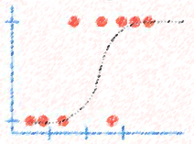

Lecture 4: Logistic Regression
CSE445 Machine Learning
Dr. Jilan Samiuddin (JSA)
Assistant Professor
North South University

Slide 2
Introduction
Logistic regression is a supervised machine learning algorithm used for classification tasks, not regression tasks – despite the misleading name
The term "regression" comes from the fact that logistic regression models a relationship between input features and a probability using a regression-like approach
Goal is to predict the probability that an instance belongs to a given class or not
It uses the sigmoid function, which takes a combination of input features and outputs a probability between 0 and 1, indicating the likelihood that the input belongs to the positive class
In logistic regression, instead of fitting a straight line like in linear regression, we fit an S-shaped curve called the logistic (or sigmoid) function. This function outputs values between 0 and 1, representing probabilities, and helps in predicting binary outcomes.

Slide 3
Types of Logistic Regression
Binomial Logistic Regression: Used when the dependent variable has two possible outcomes, such as yes/no, pass/fail, or 0/1.
Multinomial Logistic Regression: Applied when the dependent variable has three or more unordered categories, like cat, dog, or sheep – where there is no natural order.
Ordinal Logistic Regression: Used when the dependent variable has three or more ordered categories, such as low, medium, or high – where the categories follow a meaningful sequence.

Slide 4
Assumptions
Logistic regression relies on several key assumptions to ensure valid and reliable results:
Independence of Observations: Each data point should be independent; there must be no relationship or correlation between the residuals (prediction errors) of different observations.
Binary Outcome: The dependent variable must be dichotomous, taking only two possible values (e.g., 0/1, yes/no). For problems with more than two categories, extensions like multinomial logistic regression with a SoftMax link function are used.
Absence of Extreme Outliers: The dataset should not contain influential outliers, as these can unduly affect the estimated coefficients and distort the model’s performance.
Sufficient Sample Size: A large enough sample ensures stable coefficient estimates. A common rule of thumb is at least 10 events (cases of the less-frequent outcome) per predictor variable.

Slide 5
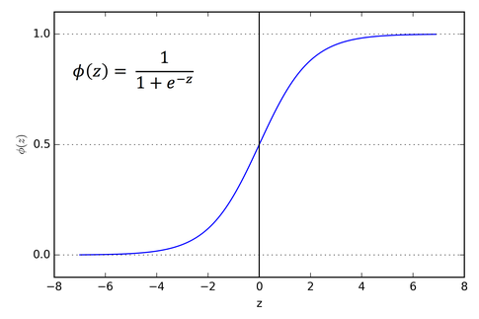
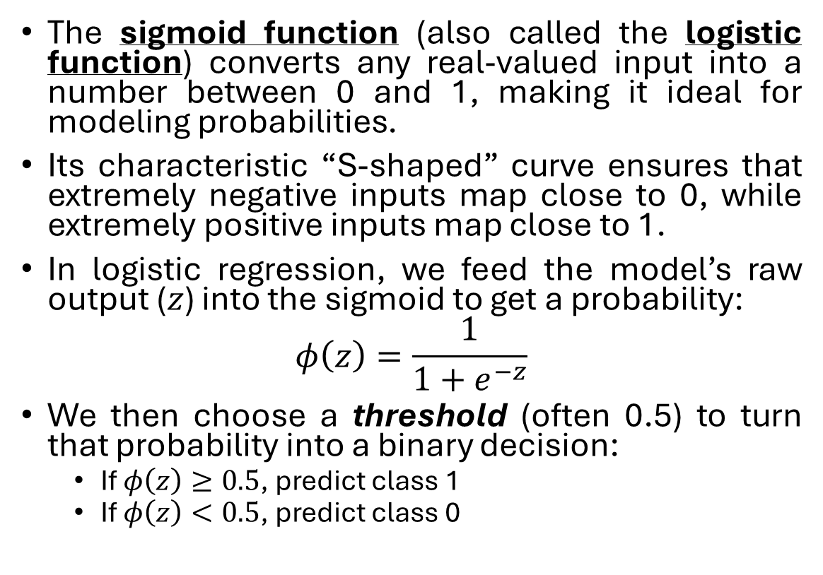
Sigmoid Function
The sigmoid function (also called the logistic function) converts any real-valued input into a number between 0 and 1, making it ideal for modeling probabilities.
Its characteristic “S-shaped” curve ensures that extremely negative inputs map close to 0, while extremely positive inputs map close to 1.
In logistic regression, we feed the model’s raw output ($z$) into the sigmoid to get a probability:
$$φ\left(z\right)=\frac{1}{1+e^{−z}}$$
We then choose a threshold (often 0.5) to turn that probability into a binary decision:
If $φ\left(z\right)≥0.5$, predict class 1
If $φ\left(z\right)<0.5$, predict class 0
Image source: Medium.com

Slide 6
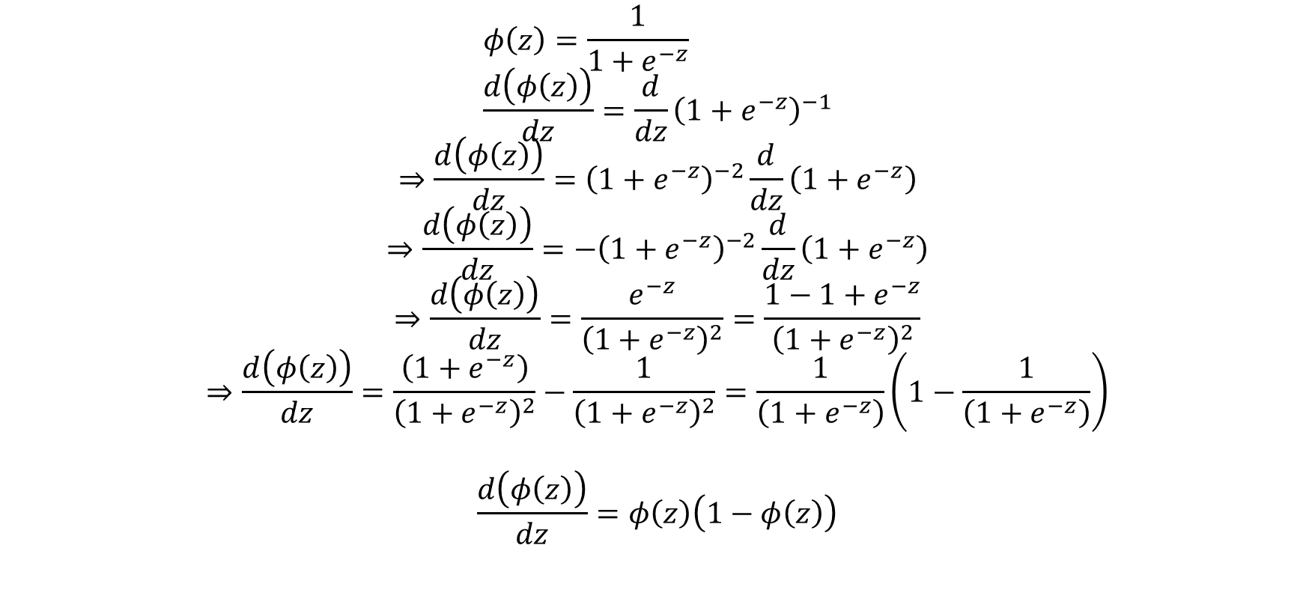
Let’s take derivative of 𝜙(𝑧): We will need it!
$$φ\left(z\right)=\frac{1}{1+e^{−z}} \\ \frac{d\left(φ\left(z\right)\right)}{dz}={\frac{d}{dz}\left(1+e^{−z}\right)}^{−1}$$
$$⇒\frac{d\left(φ\left(z\right)\right)}{dz}={\left(1+e^{−z}\right)}^{−2}\frac{d}{dz}\left(1+e^{−z}\right)$$
$$⇒\frac{d\left(φ\left(z\right)\right)}{dz}={−\left(1+e^{−z}\right)}^{−2}\frac{d}{dz}\left(1+e^{−z}\right)$$
$$⇒\frac{d\left(φ\left(z\right)\right)}{dz}=\frac{e^{−z}}{{\left(1+e^{−z}\right)}^{2}}=\frac{{1−1+e}^{−z}}{{\left(1+e^{−z}\right)}^{2}}$$
$$⇒\frac{d\left(φ\left(z\right)\right)}{dz}=\frac{\left(1+e^{−z}\right)}{{\left(1+e^{−z}\right)}^{2}}−\frac{1}{{\left(1+e^{−z}\right)}^{2}}=\frac{1}{\left(1+e^{−z}\right)}\left(1−\frac{1}{\left(1+e^{−z}\right)}\right)$$
$$\frac{d\left(φ\left(z\right)\right)}{dz}=φ\left(z\right)\left(1−φ\left(z\right)\right)$$

Slide 7
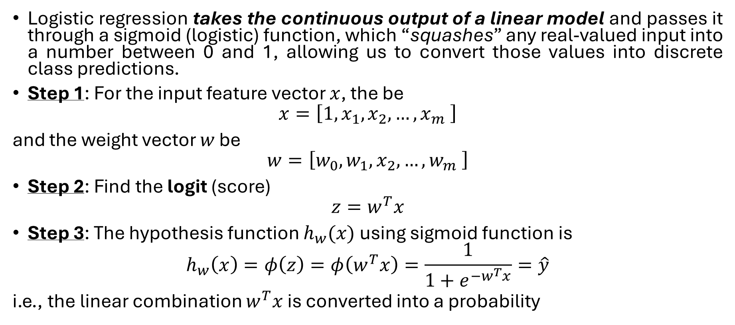
Mathematical Framework: Bionomial
Logistic regression takes the continuous output of a linear model and passes it through a sigmoid (logistic) function, which “squashes” any real-valued input into a number between 0 and 1, allowing us to convert those values into discrete class predictions.
Step 1: For the input feature vector $x$, the be
$$x=\left[1,x_{1},x_{2},…,x_{m} \right]$$
and the weight vector $w$ be
$$w=\left[w_{0},w_{1},x_{2},…,w_{m} \right]$$
Step 2: Find the logit (score)
$$z=w^{T}x$$
Step 3: The hypothesis function $h_{w}(x)$ using sigmoid function is
$$h_{w}\left(x\right)=φ\left(z\right)=φ\left(w^{T}x\right)=\frac{1}{1+e^{−w^{T}x}}=\hat{y}$$
i.e., the linear combination $w^{T}x$ is converted into a probability

Slide 8
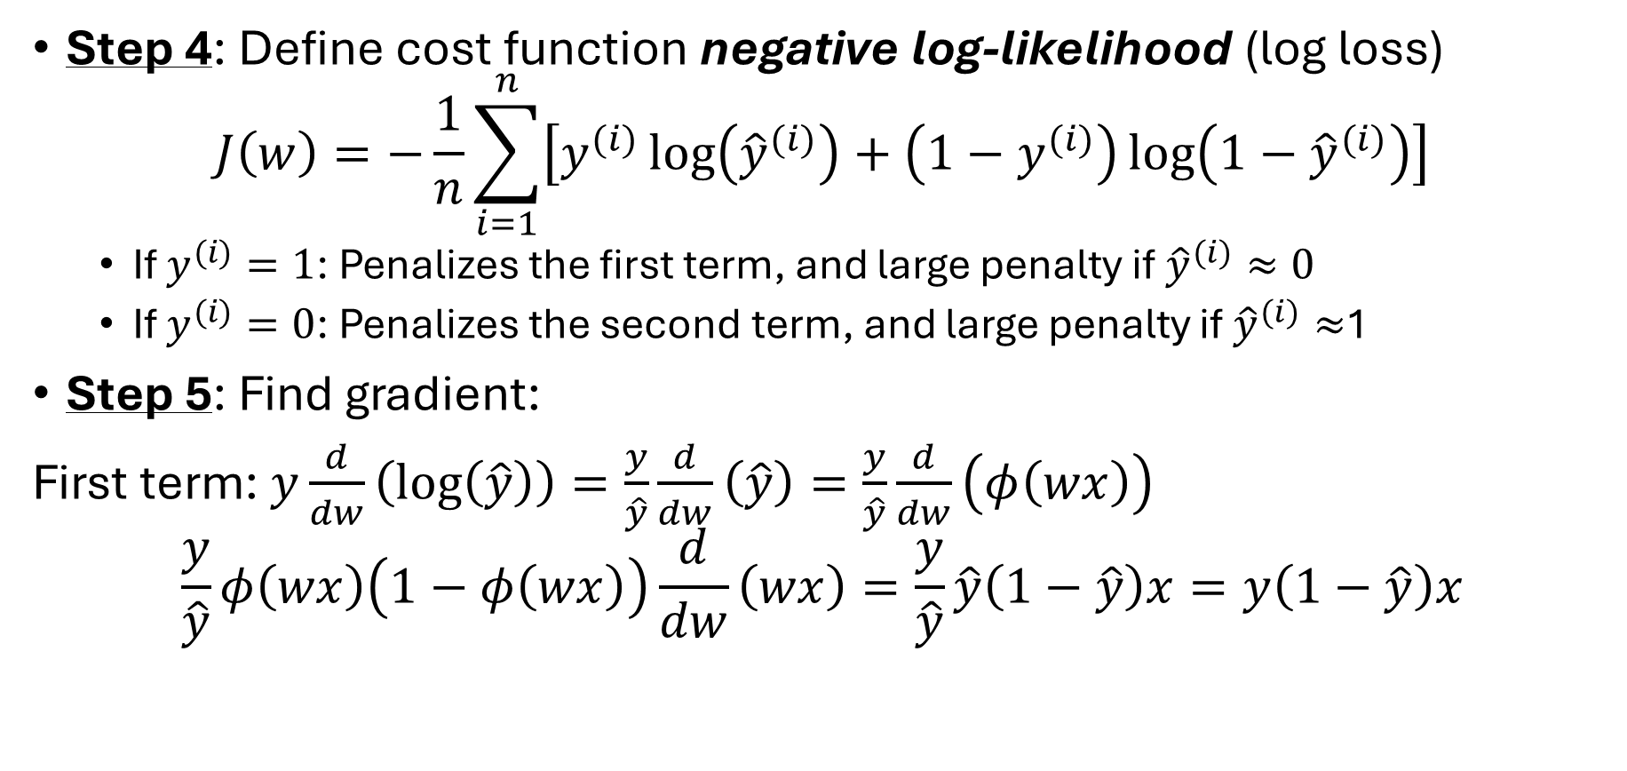
Bionomial Framework (contd.)
Step 4: Define cost function negative log-likelihood (log loss)
$$J\left(w\right)=−\frac{1}{n}\sum_{i=1}^{n}{\left[y^{(i)}\log\left({\hat{y}}^{(i)}\right)+\left(1−y^{(i)}\right)\log\left(1−{\hat{y}}^{(i)}\right)\right]}$$
If $y^{(i)}=1$: Penalizes the first term, and large penalty if${\hat{y}}^{(i)}≈0$
If $y^{(i)}=0$: Penalizes the second term, and large penalty if ${\hat{y}}^{(i)}≈$1
Step 5: Find gradient:
First term: $y\frac{d}{dw}\left(\log\left(\hat{y}\right)\right)=\frac{y}{\hat{y}}\frac{d}{dw}\left(\hat{y}\right)=\frac{y}{\hat{y}}\frac{d}{dw}\left(φ\left(wx\right)\right)$
$$\frac{y}{\hat{y}}φ\left(wx\right)\left(1−φ\left(wx\right)\right)\frac{d}{dw}\left(wx\right)=\frac{y}{\hat{y}}\hat{y}\left(1−\hat{y}\right)x=y\left(1−\hat{y}\right)x$$

Slide 9
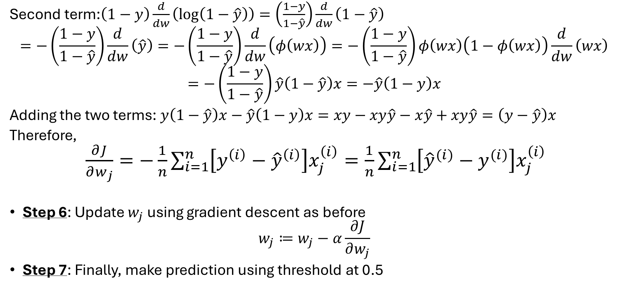
Bionomial Framework (contd.)
Second term:$\left(1−y\right)\frac{d}{dw}\left(\log\left(1−\hat{y}\right)\right)=\left(\frac{1−y}{1−\hat{y}}\right)\frac{d}{dw}\left(1−\hat{y}\right)$
$$=−\left(\frac{1−y}{1−\hat{y}}\right)\frac{d}{dw}\left(\hat{y}\right)=−\left(\frac{1−y}{1−\hat{y}}\right)\frac{d}{dw}\left(φ\left(wx\right)\right)=−\left(\frac{1−y}{1−\hat{y}}\right)φ\left(wx\right)\left(1−φ\left(wx\right)\right)\frac{d}{dw}\left(wx\right)$$
$$=−\left(\frac{1−y}{1−\hat{y}}\right)\hat{y}\left(1−\hat{y}\right)x=−\hat{y}\left(1−y\right)x$$
Adding the two terms: $y\left(1−\hat{y}\right)x−\hat{y}\left(1−y\right)x=xy−xy\hat{y}−x\hat{y}+xy\hat{y}=\left(y−\hat{y}\right)x$
Therefore,
$\frac{∂J}{∂w_{j}}=−\frac{1}{n}\sum_{i=1}^{n}{\left[{y^{\left(i\right)}−\hat{y}}^{\left(i\right)}\right]x_{j}^{\left(i\right)}}=\frac{1}{n}\sum_{i=1}^{n}{\left[{\hat{y}}^{(i)}−y^{(i)}\right]x_{j}^{\left(i\right)}}$
Step 6: Update $w_{j}$ using gradient descent as before
$$w_{j}≔w_{j}−α\frac{∂J}{∂w_{j}}$$
Step 7: Finally, make prediction using threshold at 0.5

Slide 10
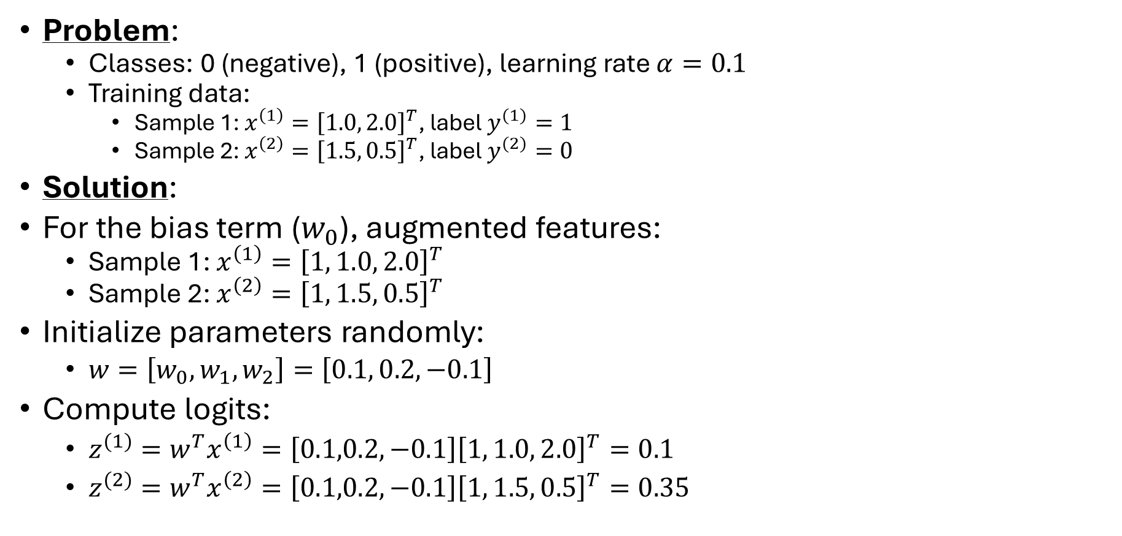
Example (Bionomial)
Problem:
Classes: 0 (negative), 1 (positive), learning rate $α=0.1$
Training data:
Sample 1: $x^{\left(1\right)}={\left[1.0, 2.0\right]}^{T}$, label $y^{(1)}=1$
Sample 2: $x^{\left(2\right)}={\left[1.5, 0.5\right]}^{T}$, label $y^{(2)}=0$
Solution:
For the bias term ($w_{0}$), augmented features:
Sample 1: $x^{\left(1\right)}={\left[1, 1.0, 2.0\right]}^{T}$
Sample 2: $x^{\left(2\right)}={\left[1, 1.5, 0.5\right]}^{T}$
Initialize parameters randomly:
$w=\left[w_{0},w_{1},w_{2}\right]=\left[0.1, 0.2,−0.1\right]$
Compute logits:
$z^{(1)}=w^{T}x^{\left(1\right)}=\left[0.1,0.2,−0.1\right]{\left[1, 1.0, 2.0\right]}^{T}=0.1$
$z^{(2)}=w^{T}x^{\left(2\right)}=\left[0.1,0.2,−0.1\right]{\left[1, 1.5, 0.5\right]}^{T}=0.35$

Slide 11
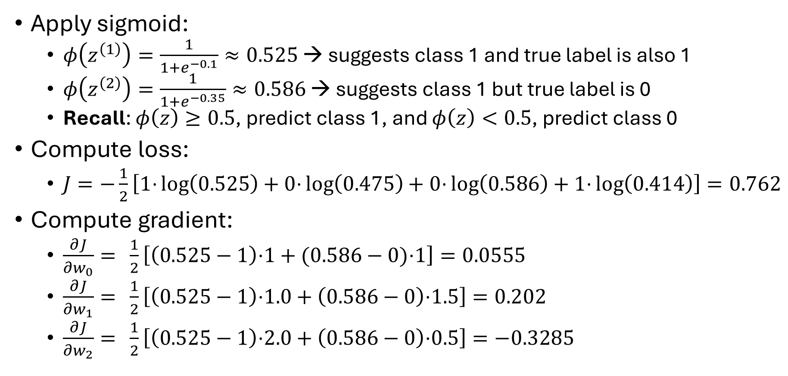
Example (contd.)
Apply sigmoid:
$φ\left(z^{\left(1\right)}\right)=\frac{1}{1+e^{−0.1}}≈0.525$ → suggests class 1 and true label is also 1
$φ\left(z^{\left(2\right)}\right)=\frac{1}{1+e^{−0.35}}≈0.586$ → suggests class 1 but true label is 0
Recall: $φ\left(z\right)≥0.5$, predict class 1, and $φ\left(z\right)<0.5$, predict class 0
Compute loss:
$J=−\frac{1}{2}\left[1\text{⋅}\log\left(0.525\right)+0\text{⋅}\log\left(0.475\right)+0\text{⋅}\log\left(0.586\right)+1\text{⋅}\log\left(0.414\right)\right]=0.762$
Compute gradient:
$\frac{∂J}{∂w_{0}}= \frac{1}{2}\left[\left(0.525−1\right)\text{⋅}1+(0.586−0)\text{⋅}1\right]=0.0555$
$\frac{∂J}{∂w_{1}}= \frac{1}{2}\left[\left(0.525−1\right)\text{⋅}1.0+\left(0.586−0\right)\text{⋅}1.5\right]=0.202$
$\frac{∂J}{∂w_{2}}= \frac{1}{2}\left[\left(0.525−1\right)\text{⋅}2.0+\left(0.586−0\right)\text{⋅}0.5\right]=−0.3285$

Slide 12
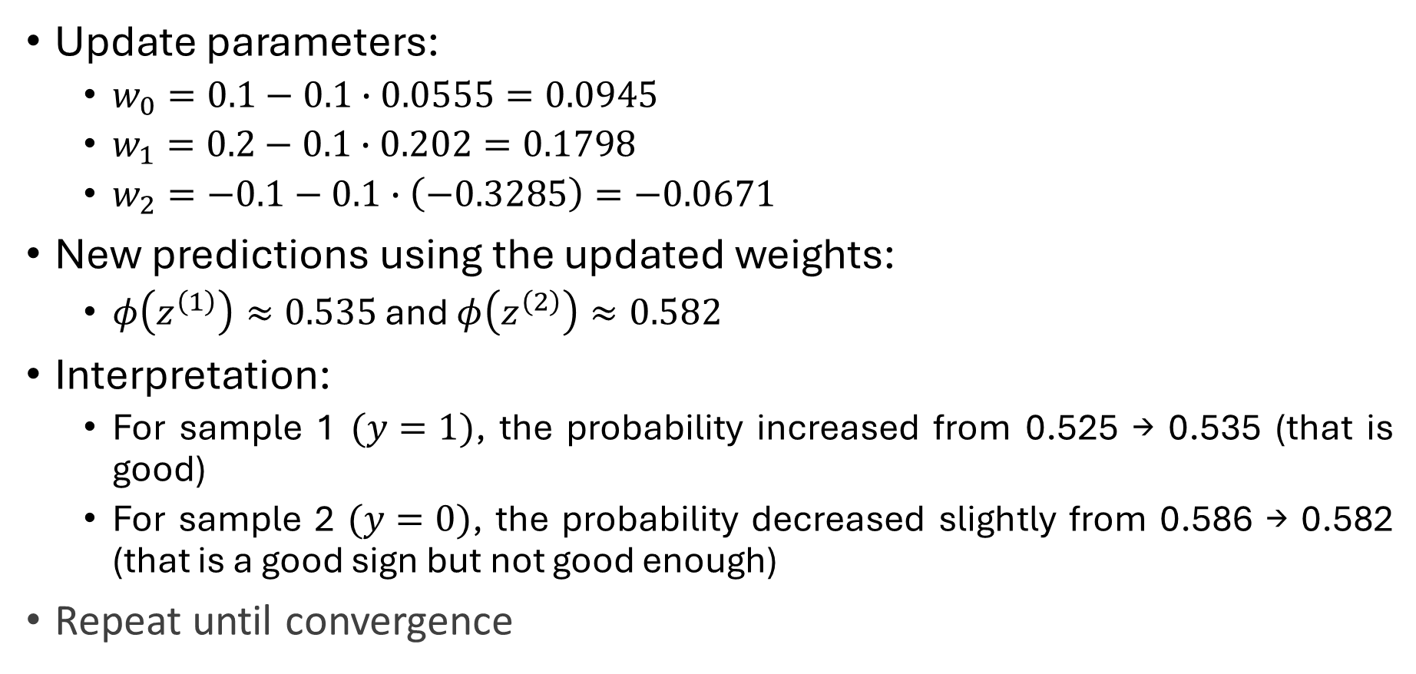
Example (contd.)
Update parameters:
$w_{0}=0.1−0.1∙0.0555=0.0945$
$w_{1}=0.2−0.1∙0.202=0.1798$
$w_{2}=−0.1−0.1∙\left(−0.3285\right)=−0.0671$
New predictions using the updated weights:
$φ\left(z^{\left(1\right)}\right)≈0.535$ and $φ\left(z^{\left(2\right)}\right)≈0.582$
Interpretation:
For sample 1 $(y=1)$, the probability increased from 0.525 → 0.535 (that is good)
For sample 2 $(y=0)$, the probability decreased slightly from 0.586 → 0.582 (that is a good sign but not good enough)
Repeat until convergence

Slide 13
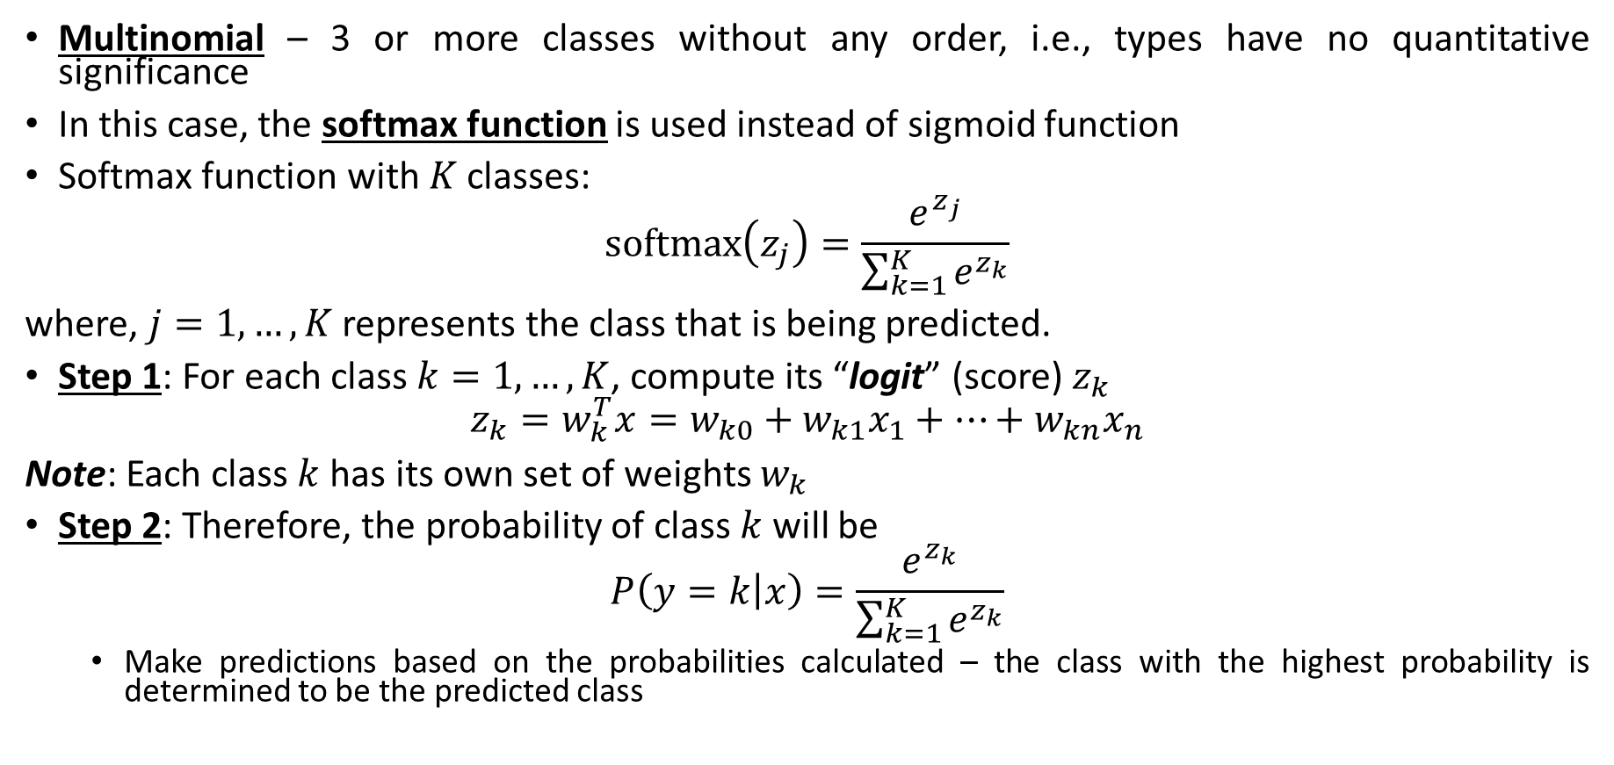
Mathematical Framework: Multinomial
Multinomial – 3 or more classes without any order, i.e., types have no quantitative significance
In this case, the softmax function is used instead of sigmoid function
Softmax function with $K$ classes:
$$softmax\left(z_{j}\right)=\frac{e^{z_{j}}}{\sum_{k=1}^{K}{e^{z_{k}}}}$$
where, $j=1,…,K$ represents the class that is being predicted.
Step 1: For each class $k=1,…,K$, compute its “logit” (score) $z_{k}$
$$z_{k}=w_{k}^{T}x=w_{k0}+w_{k1}x_{1}+…+w_{kn}x_{n}$$
Note: Each class $k$ has its own set of weights $w_{k}$
Step 2: Therefore, the probability of class $k$ will be
$$P\left(y=k | x\right)=\frac{e^{z_{k}}}{\sum_{k=1}^{K}{e^{z_{k}}}}$$
Make predictions based on the probabilities calculated – the class with the highest probability is determined to be the predicted class

Slide 14
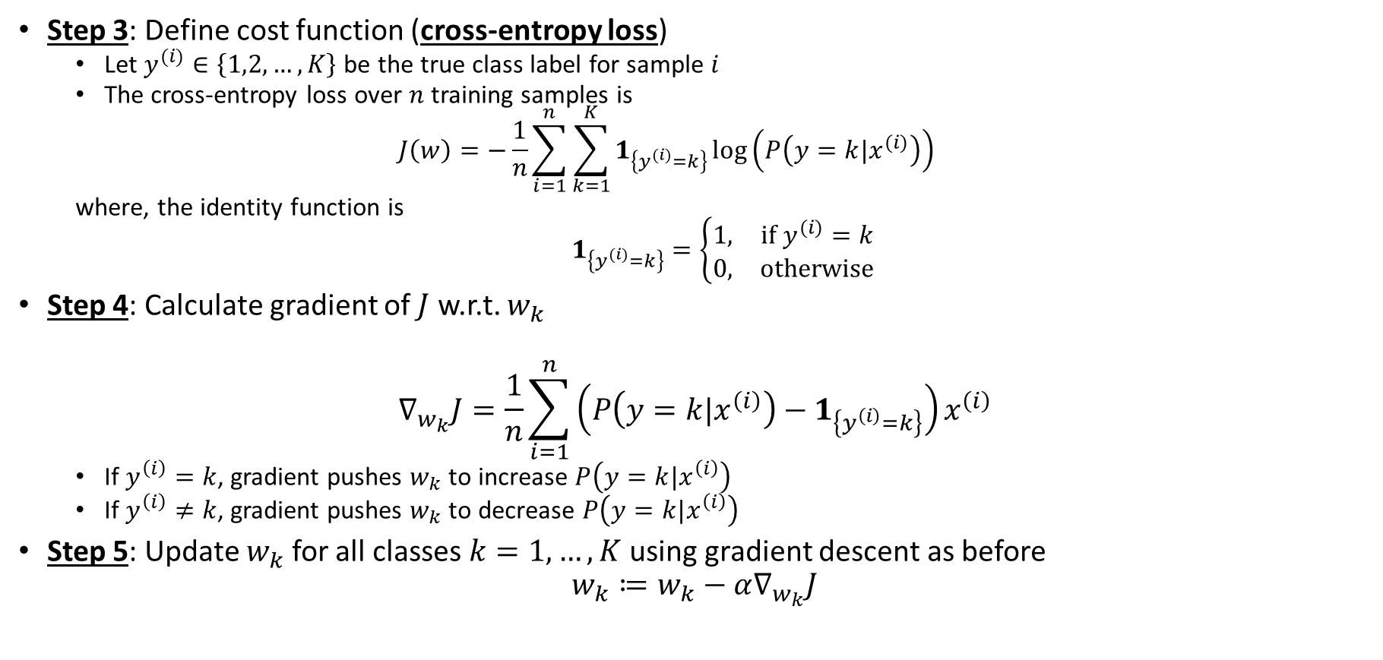
Multinomial Framework (contd.)
Step 3: Define cost function (cross-entropy loss)
Let $y^{(i)}∈\left\{1,2,…,K\right\}$ be the true class label for sample $i$
The cross-entropy loss over $n$ training samples is
$$J\left(w\right)=−\frac{1}{n}\sum_{i=1}^{n}{\sum_{k=1}^{K}{1_{\left\{y^{(i)}=k\right\}}\log\left(P\left(y=k|x^{(i)}\right)\right)}}$$
where, the identity function is
$1_{\left\{y^{(i)}=k\right\}}=\left\{\begin{matrix}1, & if{ y}^{(i)}=k \\ 0, & otherwise\end{matrix}\right.$
Step 4: Calculate gradient of $J$ w.r.t. $w_{k}$
$$∇_{w_{k}}J=\frac{1}{n}\sum_{i=1}^{n}{\left(P\left(y=k|x^{\left(i\right)}\right)−1_{\left\{y^{\left(i\right)}=k\right\}}\right)}x^{\left(i\right)}$$
If $y^{\left(i\right)}=k$, gradient pushes $w_{k}$ to increase $P\left(y=k|x^{\left(i\right)}\right)$
If $y^{\left(i\right)}≠k$, gradient pushes $w_{k}$ to decrease $P\left(y=k|x^{\left(i\right)}\right)$
Step 5: Update $w_{k}$ for all classes $k=1,…,K$using gradient descent as before
$$w_{k}≔w_{k}−α∇_{w_{k}}J$$

Slide 15
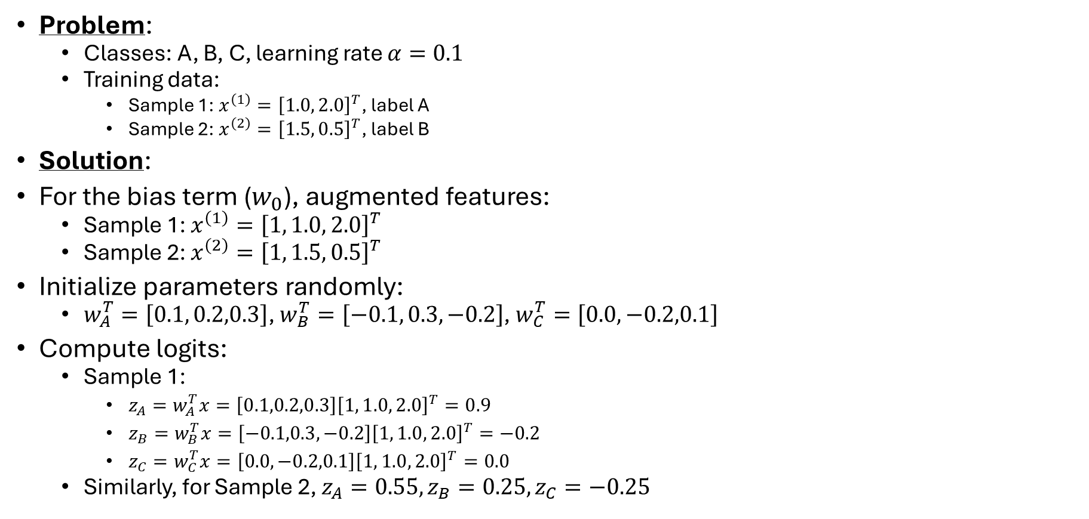
Example (Multinomial)
Problem:
Classes: A, B, C, learning rate $α=0.1$
Training data:
Sample 1: $x^{\left(1\right)}={\left[1.0, 2.0\right]}^{T}$, label A
Sample 2: $x^{\left(2\right)}={\left[1.5, 0.5\right]}^{T}$, label B
Solution:
For the bias term ($w_{0}$), augmented features:
Sample 1: $x^{\left(1\right)}={\left[1, 1.0, 2.0\right]}^{T}$
Sample 2: $x^{\left(2\right)}={\left[1, 1.5, 0.5\right]}^{T}$
Initialize parameters randomly:
$w_{A}^{T}=\left[0.1, 0.2,0.3\right]$, $w_{B}^{T}=\left[−0.1, 0.3,−0.2\right]$, $w_{C}^{T}=\left[0.0, −0.2,0.1\right]$
Compute logits:
Sample 1:
$z_{A}=w_{A}^{T}x=\left[0.1,0.2,0.3\right]{\left[1, 1.0, 2.0\right]}^{T}=0.9$
$z_{B}=w_{B}^{T}x=\left[−0.1,0.3,−0.2\right]{\left[1, 1.0, 2.0\right]}^{T}=−0.2$
$z_{C}=w_{C}^{T}x=\left[0.0,−0.2,0.1\right]{\left[1, 1.0, 2.0\right]}^{T}=0.0$
Similarly, for Sample 2, $z_{A}=0.55, z_{B}=0.25, z_{C}=−0.25$

Slide 16
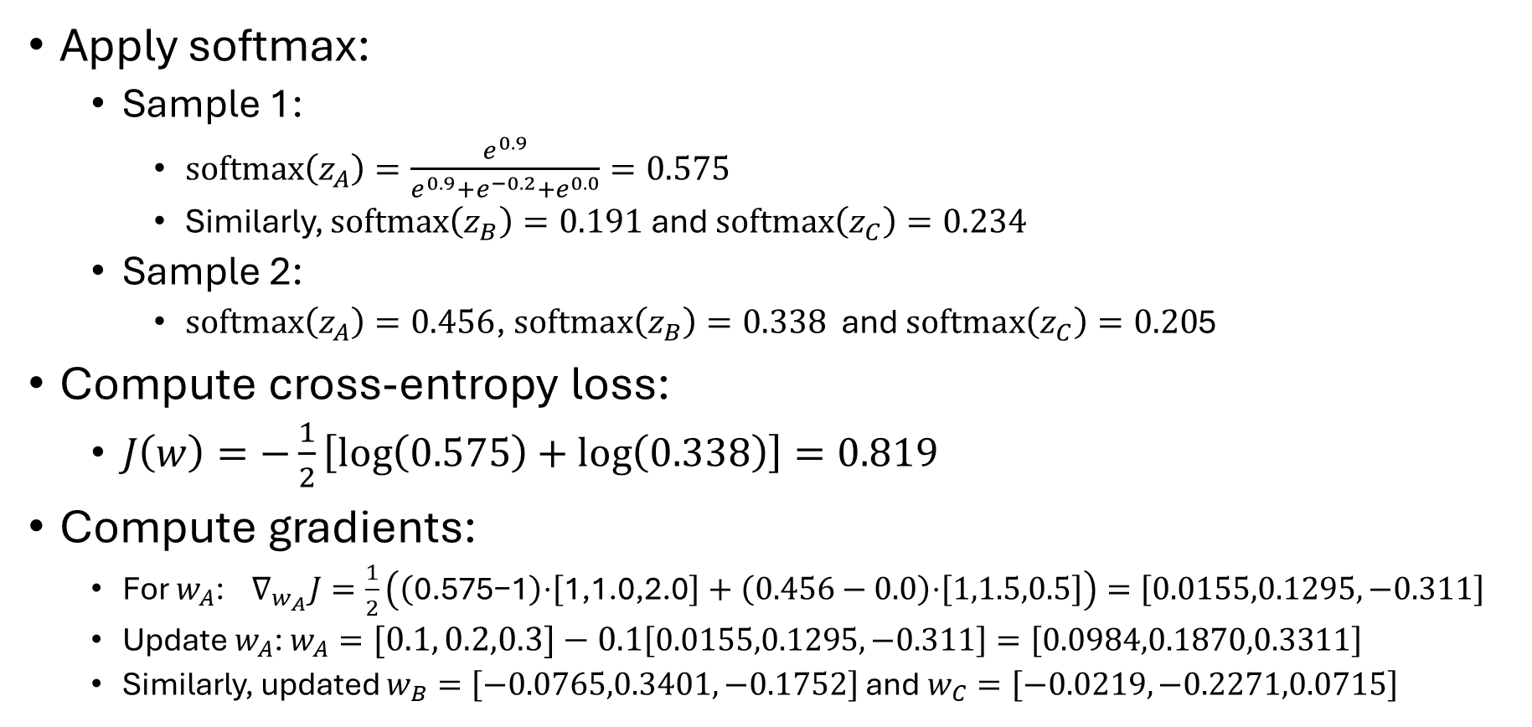
Example (contd.)
Apply softmax:
Sample 1:
$softmax\left(z_{A}\right)=\frac{e^{0.9}}{e^{0.9}+e^{−0.2}+e^{0.0}}=0.575$
Similarly, $softmax\left(z_{B}\right)=0.191$ and $softmax\left(z_{C}\right)=0.234$
Sample 2:
$softmax\left(z_{A}\right)=0.456$, $softmax\left(z_{B}\right)=0.338$ and $softmax\left(z_{C}\right)=0.20$5
Compute cross-entropy loss:
$J\left(w\right)=−\frac{1}{2}\left[\log\left(0.575\right)+\log\left(0.338\right)\right]=0.819$
Compute gradients:
For $w_{A}$: $∇_{w_{A}}J=\frac{1}{2}\left(\left(\text{0.575−1}\right)\text{⋅}\left[\text{1,1.0,2.0}\right]+\left(0.456−0.0\right)\text{⋅}\left[1,1.5,0.5\right]\right)=\left[0.0155,0.1295,−0.311\right]$
Update $w_{A}$: $w_{A}=\left[0.1, 0.2,0.3\right]−0.1\left[0.0155,0.1295,−0.311\right]=\left[0.0984,0.1870,0.3311\right]$
Similarly, updated $w_{B}=\left[−0.0765,0.3401,−0.1752\right]$ and $w_{C}=\left[−0.0219,−0.2271,0.0715\right]$

Slide 17
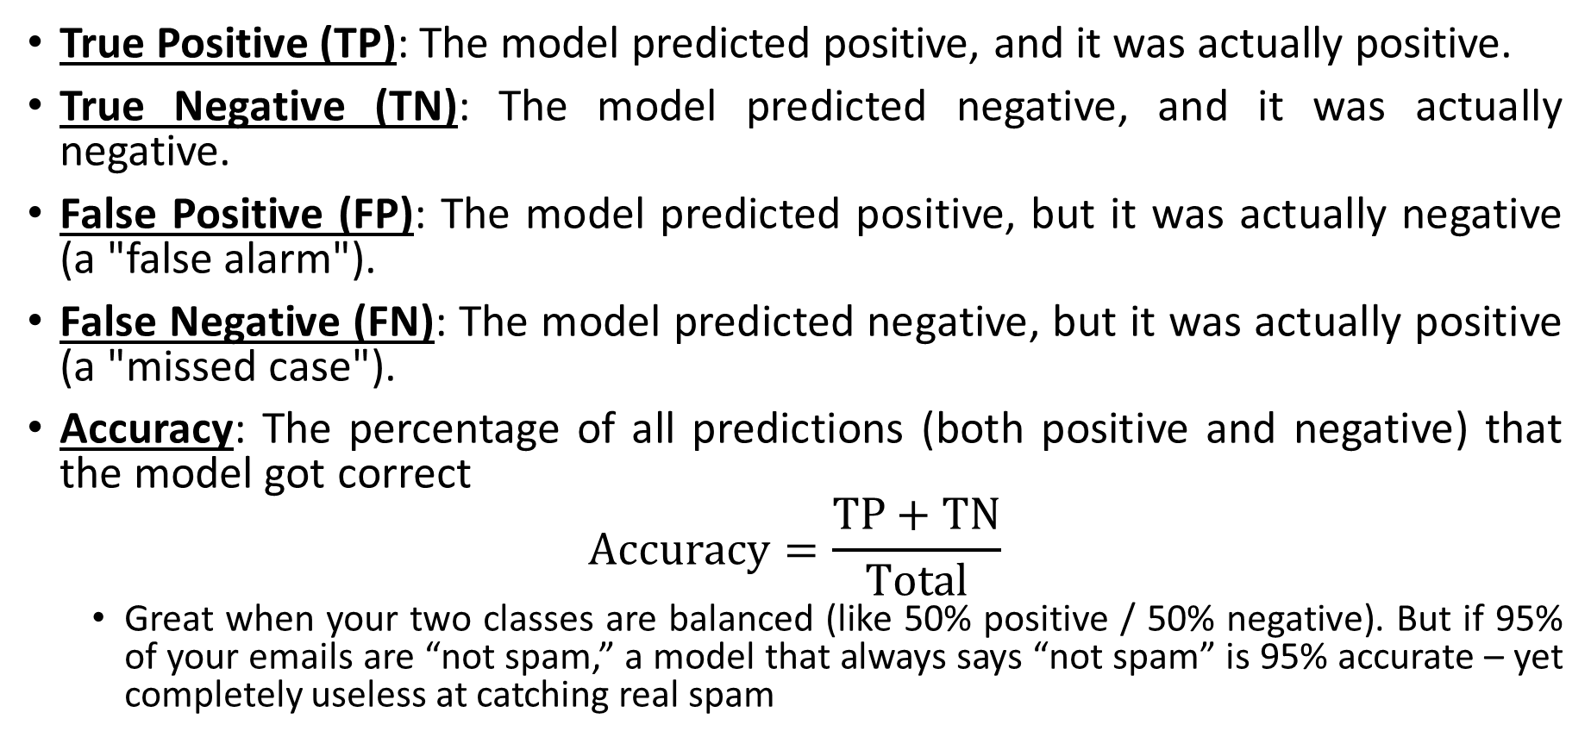
Evaluation Metrics
True Positive (TP): The model predicted positive, and it was actually positive.
True Negative (TN): The model predicted negative, and it was actually negative.
False Positive (FP): The model predicted positive, but it was actually negative (a "false alarm").
False Negative (FN): The model predicted negative, but it was actually positive (a "missed case").
Accuracy: The percentage of all predictions (both positive and negative) that the model got correct
$$Accuracy=\frac{TP+TN}{Total}$$
Great when your two classes are balanced (like 50% positive / 50% negative). But if 95% of your emails are “not spam,” a model that always says “not spam” is 95% accurate – yet completely useless at catching real spam

Slide 18
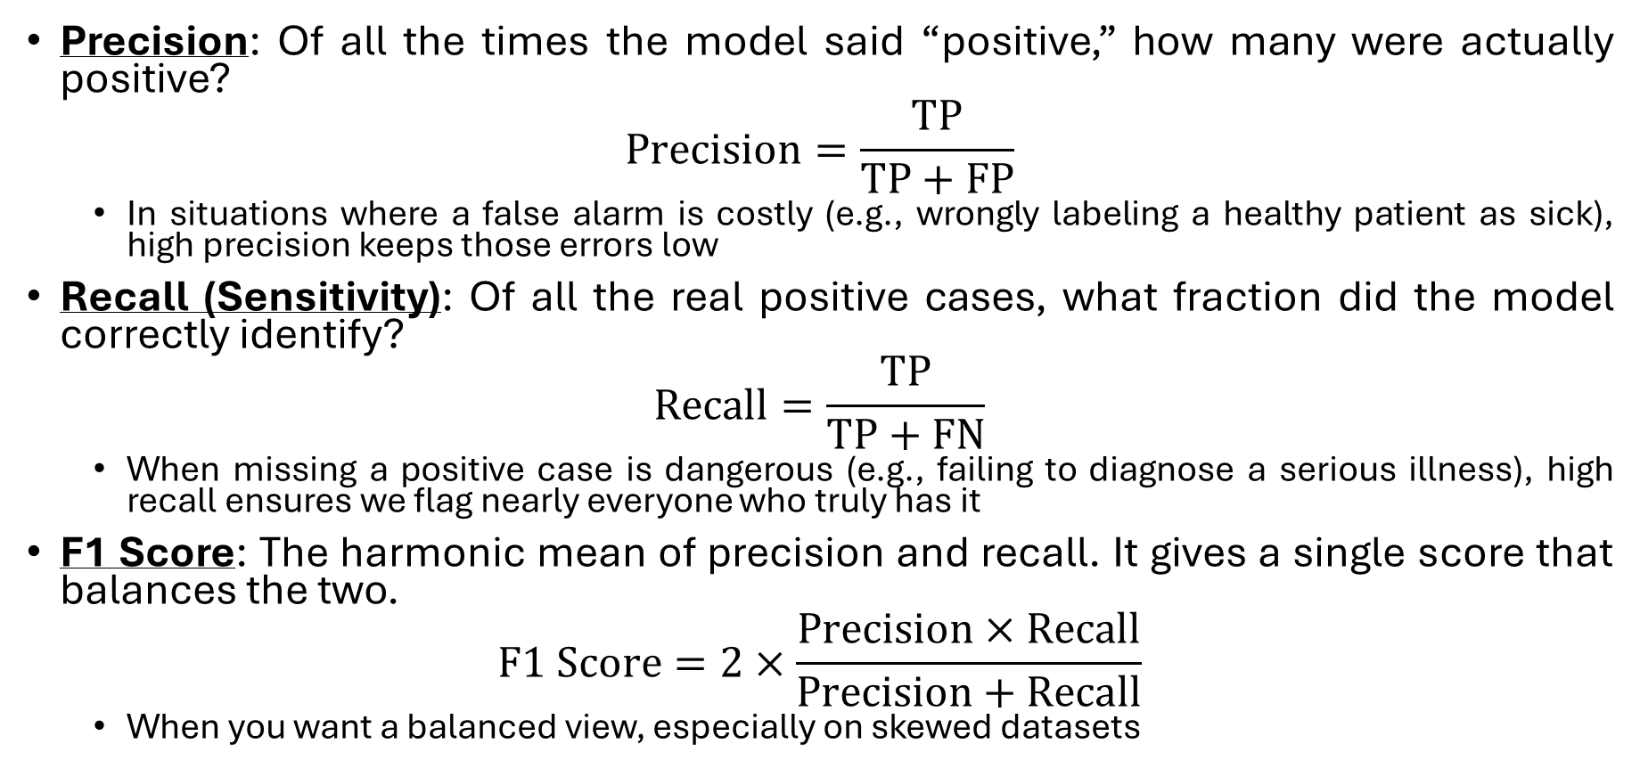
Evaluation Metrics (contd.)
Precision: Of all the times the model said “positive,” how many were actually positive?
$$Precision=\frac{TP}{TP+FP}$$
In situations where a false alarm is costly (e.g., wrongly labeling a healthy patient as sick), high precision keeps those errors low
Recall (Sensitivity): Of all the real positive cases, what fraction did the model correctly identify?
$$Recall=\frac{TP}{TP+FN}$$
When missing a positive case is dangerous (e.g., failing to diagnose a serious illness), high recall ensures we flag nearly everyone who truly has it
F1 Score: The harmonic mean of precision and recall. It gives a single score that balances the two.
$$F1 Score=2×\frac{Precision×Recall}{Precision+Recall}$$
When you want a balanced view, especially on skewed datasets

Slide 19
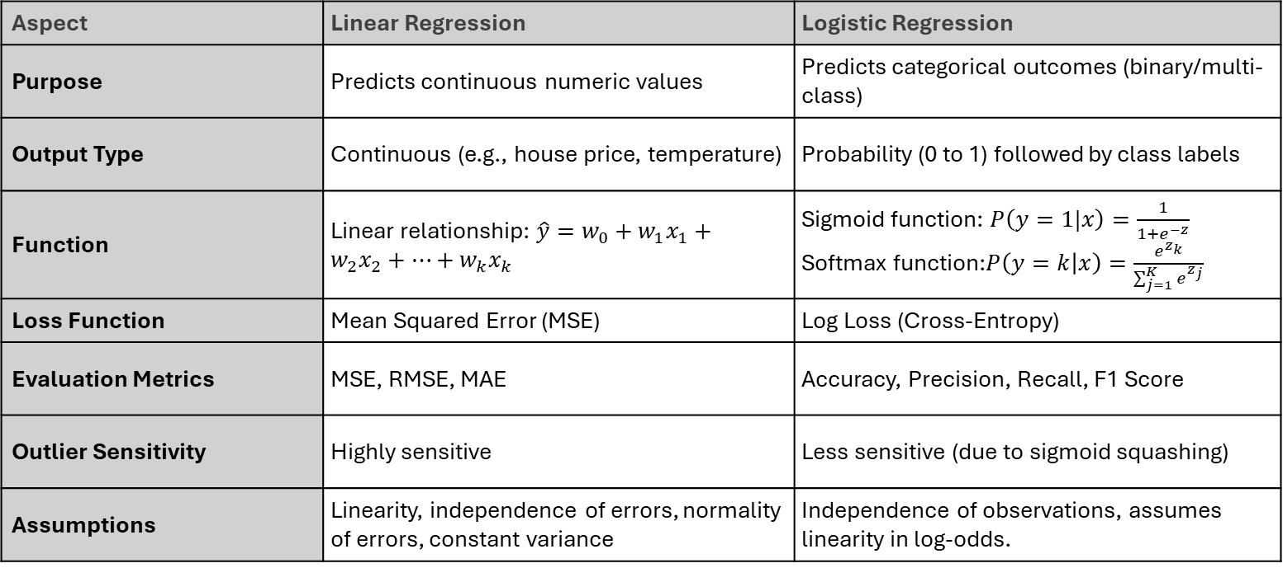
Linear Regression vs Logistic Regression
Aspect | Linear Regression | Logistic Regression
Purpose | Predicts continuous numeric values | Predicts categorical outcomes (binary/multi-class)
Output Type | Continuous (e.g., house price, temperature) | Probability (0 to 1) followed by class labels
Function | Linear relationship: $\hat{y}=w_{0}+w_{1}x_{1}+w_{2}x_{2}+…+w_{k}x_{k}$ | Sigmoid function: $P\left(y=1|x\right)=\frac{1}{1+e^{−z}}$ Softmax function:$P\left(y=k | x\right)=\frac{e^{z_{k}}}{\sum_{j=1}^{K}{e^{z_{j}}}}$
Loss Function | Mean Squared Error (MSE) | Log Loss (Cross-Entropy)
Evaluation Metrics | MSE, RMSE, MAE | Accuracy, Precision, Recall, F1 Score
Outlier Sensitivity | Highly sensitive | Less sensitive (due to sigmoid squashing)
Assumptions | Linearity, independence of errors, normality of errors, constant variance | Independence of observations, assumes linearity in log-odds.

